Slide 1
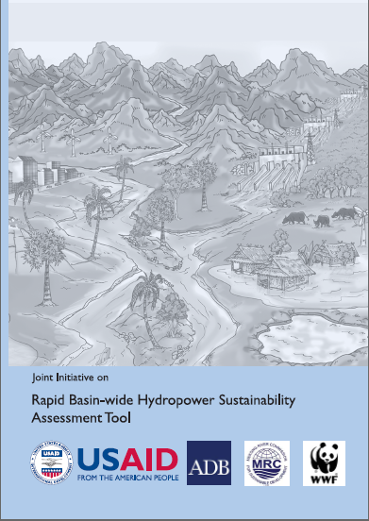
Rapid Sustainability Assessment Tool - RSAT
Voradeth Phonekeo
1st December 2011

Slide 2
Aim of today presentation
What is RSAT?
How might RSAT contribute to improving hydropower quality, actor responsibility and project sustainability?
How RSAT can help basin development planning, and RBOs functions?
Notes:
Give a briefing on the RSAT,
its concept,
its potential use
the users, and

Slide 3
What is the Rapid Sustainability Assessment Tool (RSAT)?
The RSAT is a tool used to assist decision making for sustainable hydropower development in the Mekong River Basin.
What methods does it use?
Participatory SWOT analysis
Multi-stakeholder dialogue
Evidence based scoring against criteria
Gap analysis
Action planning
Notes:
What is the tool designed to assess?
A single hydropower project and its relationship to a sub-basin;
Existing and proposed cascades of hydropower projects within a sub-basin or multiple projects within a sub-basin (or 2nd order sub-basin tributary);
A sub-basin as a whole that has hydropower potential; and
Transboundary issues for basins shared by different countries, where hydropower is already developed or could be developed in future

Slide 4
How might RSAT contribute to improving hydropower quality, project sustainability?
The tool is designed to assess:
A single hydropower project and its relationship to a sub-basin;
Existing and proposed cascades of hydropower projects within a sub-basin or multiple projects within a sub-basin (or 2nd order sub-basin tributary);
A sub-basin as a whole that has hydropower potential; and
Transboundary issues for basins shared by different countries, where hydropower is already developed or could be developed in future
Notes:
actor responsibility and
What does RSAT contribute ?
Integrated assessment of hydropower beyond individual project
Identifies key risks and opportunities
Identifies roles and responsibilities in a basin context
Institutional gap analysis
Outputs can be used for watershed planning
A planning framework for river basin organisations

Slide 5
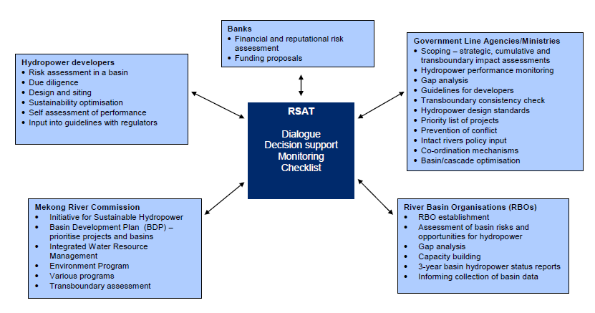
Key players
Key sub- basin stakeholders
  National regulatory agencies / line agencies
  Provincial agencies
  River basin entity (emergent or proxy)
  Hydropower developers / operators
  Transboundary and regional institutions
  Other Stakeholders:
  Project affected communities and their representatives
  Potential funding agencies, such as multilateral development banks
Notes:
Key sub- basin stakeholders
National regulatory agencies / line agencies
Provincial agencies
River basin entity (emergent or proxy)
Hydropower developers / operators
Transboundary and regional institutions
Other Stakeholders:
Project affected communities and their representatives
Potential funding agencies, such as multilateral development banks
An Assessment team of about 15 PERSONS
Duration about 7 days

Slide 6
11 RSAT Topics
Economic development of basin
Social and cultural well-being in the basin
Environmental quality of the basin
Options assessment and alignment with regional plans
Co-ordination and optimisation of multiple projects in a basin
Environmental flows and downstream regulation
Fish passage and fisheries management
Benefit sharing and financing sustainability measures
Safety and disaster prevention
Institutional setting
Stakeholder engagement and communication

Slide 7
Topic | Criteria
1: Hydropower and economic development in the basin / sub-basin | 1.1 Relative contribution of hydropower to national economies
 | 1.2 Relative contribution of hydropower to local economies
 | 1.3: Synergies and trade-offs with other economic sectors in the basin
 | 1.4: Multiple water use optimisation
2: Hydropower and social and cultural well-being in the basin / sub-basin | 2.1: Cultural values and non-material uses of resources
 | 2.2 Protection of livelihoods and land and water access rights and entitlements
 | 2.3 Involuntary re-settlement
 | 2.4 Hydropower and equitable social advancement
 | 2.5 Hydropower and poverty reduction
3: Hydropower and environmental quality and natural resources management in the basin / sub-basin | 3.1: Understanding and protection of basin-wide ecosystem integrity
 | 3.2: Management of hydropower environmental impacts
 | 3.3: Protection of high value rivers from development
 | 3.4: Hydropower impact on sustainable use of natural resources
 | 3.5 Impact on river morphology, erosion and sedimentation
 | 3.6: Monitoring changes to environmental quality as a result of hydropower
4: Options assessment and alignment with national, regional and international agreements, policies and plans | 4.1 Options assessment for water and energy services in the basin or export revenue
 | 4.2 Alignment with regional and international agreements, policies / plans and national commitments for basin development
 | 4.3 Alignment with integrated water resource management (IWRM) planning in the basin

Slide 8
5. Site selection and optimisation, sequencing and multi project co-ordination | 5.1 Multi-criteria assessment for site selection and optimisation for multiple projects in a basin or cascade
 | 5.2 Protection of unique biodiversity / habitat and culturally significant sites in hydropower site selection and design
 | 5.3 Co-ordination of planning for hydropower implementation in a basin with multiple objectives
 | 5.4 Co-ordination of planning for operations within a system of multiple reservoirs or cascade
6: Environmental flows and downstream regulation | 6.1: Environmental flow assessment (EFA)
 | 6.2: Structural provision and operational procedures for sediment management and sediment flushing during all project stages
 | 6.3 Structural provision and operational procedures for downstream flow regulation including transboundary considerations
 | 6.4 Maintaining the flow of nutrient rich silt
 | 6.5 Flood and drought management and floodplain protection
 | 6.6 River transport and navigation locks
7. Fish passage and fisheries management | 7.1 Understanding and monitoring of fisheries resources
 | 7.2 Policy, regulations and practices for fish management in hydropower
 | 7.3 Structural and operational provision for fish passage
 | 7.4 Protection of upstream and downstream fisheries and development of reservoir fisheries

Slide 9
Topic | Criteria
8: Sharing of benefits and use of innovative financing measures for sustainability (local and transboundary) | 8.1 Sharing of project benefits
 | 8.2 Equitable water resource allocation between sectors and countries
 | 8.3 Payment for ecological services (PES)
 | 8.4 Carbon financing opportunities to fund sustainability measures
 | 8.5 Project revenue to fund sustainability measures
9: Provision for safety and disaster prevention and management | 9.1 Dam safety management system (DSMS)
 | 9.2 Consistency across basin / cascade
 | 9.3: Emergency preparedness plans (EPP) and co-ordination
 | 9.4: Dam break and other analysis prepared for projects in cascades
 | 9.5: Emergency flood management
10: National and basin-wide institutional setting | 10.1 Sustainable hydropower – roles and allocation of responsibility
 | 10.2 Co-ordination mechanisms between key stakeholders
 | 10.3 Transboundary notification, conflict resolution and communication
 | 10.4 Monitoring, review and compliance provisions
 | 10.5: Sustainability principles in hydropower agreements
 | 10.6: Capacity building plans for key agencies and River Basin Organisations and Committees (RBO / RBC)
11: Communication, basin stakeholder and community involvement and support for hydropower development | 11.1 Strategic communication and awareness of sustainable hydropower – principles and practices
 | 11.2: Informed participation and representation in hydropower decision making at all stages of the project cycle
 | 11.3 Information sharing and access to data and reports
 | 11.4: Basin level community support for hydropower
 | 11.5 Integration of operations in watershed / catchment management

Slide 10
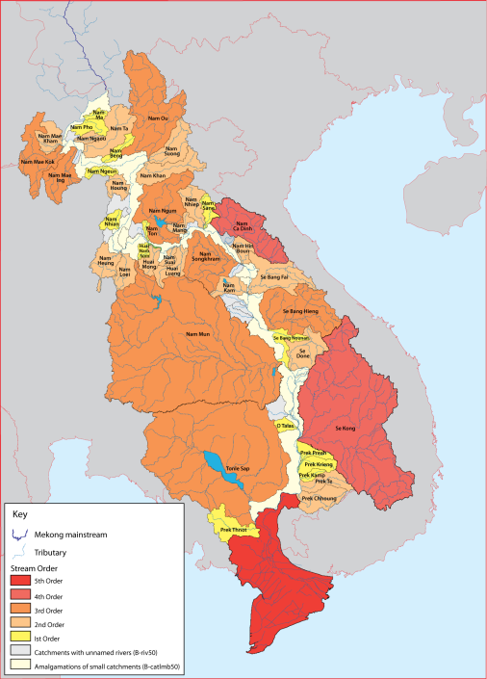
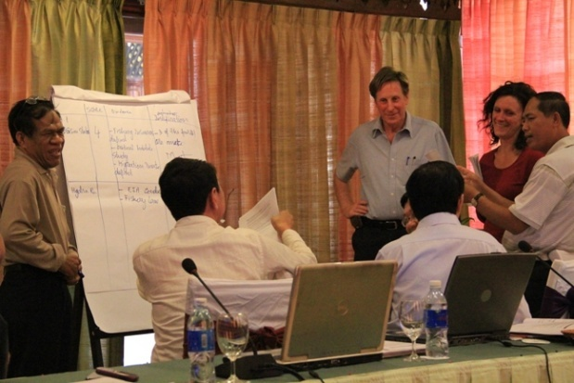
RSAT Case Studies
3S Rivers Basin
  Developing transboundary IWRM
Cascade of 7 dams in river basin (Lao PDR)
  Scoping for CIA
  Designing watershed management strategy
  Nam Ngum river basin (Lao PDR)
  Dialogue for the RBC
  Sre Pok river basin
  Upper Vietnam
  Lower Cambodia – EIA guidance
Nam Kam
Nam Ngum
3S Basin
(transboundary)
Sre Pok
Upper and Lower
Notes:
Training on RSAT assessment were done for several River Basins
RSAT Case Studies 2011
3S Rivers Basin
Developing transboundary IWRM
Cascade of 7 dams in river basin (Lao PDR)
Scoping for CIA
Designing watershed management strategy
Nam Ngum river basin (Lao PDR)
Dialogue for the RBC
Sre Pok river basin
Upper Vietnam
Lower Cambodia – EIA guidance
10

Slide 11
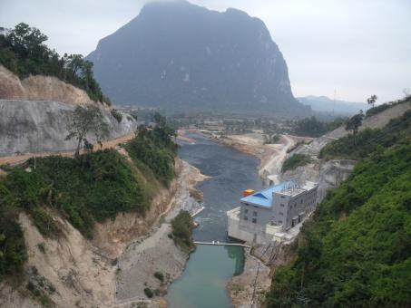
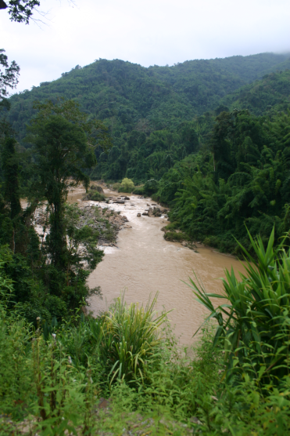
Example of RSAT analysis - Nam Ngum River Basin
  Used RSAT to identify priority actions for River Basin Committee
  Multi-stakeholder assessment team
    provincial agencies
    multi-sectoral
    hydropower developers
  Actions
    SWOT analysis
    Sustainability Scoring Identification of priority actions for RBC
  Outcomes:
  Developed understanding of sustainability issues for hydropower development in NN
  Build relationships between sectors involved in NN RBC
  Priority actions identified for NN RBC
Notes:
Each topic discussion followed a set pattern with the topic being introduced, outlining the intent and scope of the topic and the guidance provided. This was followed by a presentation of the evidence that had been collected by the consultants and the facilitators before hand. The panel members were then invited to discuss the topic and to bring additional evidence to the discussion. SWOT analyses and scoring discussions lead to the identification of at least two recommendations for priority action.

Slide 12

RSAT can be downloaded at:
http://www.mrcmekong.org/news-and-events/news/innovative-tool-for-mekong-basin-wide-sustainable-hydropower-assessment-launched/

